Slide 1
Deep (and Wide) Contextual Bandits
Week 6 Demo | 26 Feb

Slide 2
📍Where We Were
Full Dataset (~30GB) preprocessed & exported
Weekly files
with 80/20 train-valid split (12 months for train + 3 months for val)
Baseline established with Space Bandits
With latest weights + same features deployed at client side
Obtained 79.9% Acc on val
Enabling Thompson Sampling —> ~10x increase in inference time
Initial experiments with W&D and D-only models, promising
82%+ Acc (but was on a subset of val)

Slide 3
🛰️ The ∆ Overview
Full dataset (80M+ rows) infeasible for rapid iteration
~40 mins per epoch with 512 batch size
Solution: Extract subsets s.t they are as close to the full dataset distribution
Train & evaluate models on this subset
Simple User Dictionary Model
LGBM w & w/out User Dictionary Model
FCNN
FCNN with MC Dropout (Bayesian NN)
To Space Bandits or Not?

Slide 4





👶 Subsetting The Data
1) Dataset
2) % of samples to choose
Subset (% of full Dataset)
Compute
Discretize
Iterate
Accumulate
Maintain
Global summary stats & histograms for picked features
Coarse discretization of picked feature space into bins
Iterate over each of the weekly files
Accumulate samples to discretized feature space bins...
...s.t. the global distribution is maintained!

Slide 5
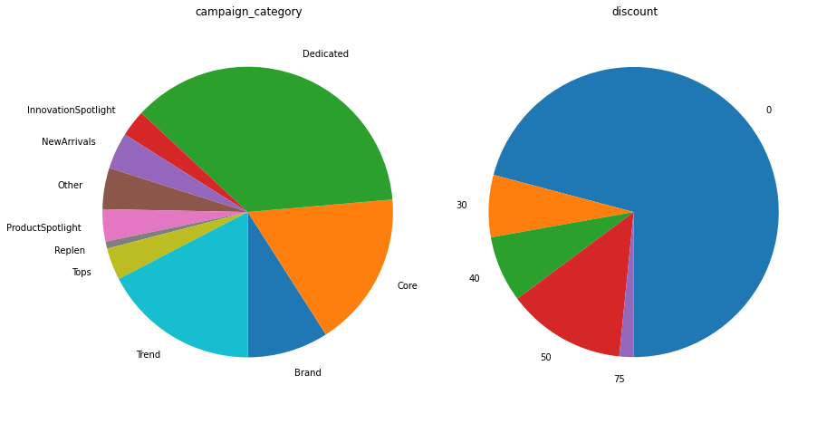
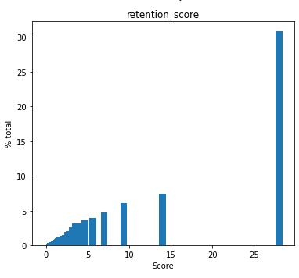
👶 Subsetting The Data (contd.)
80M+ entries but not too many unique feature values
Some numeric feature columns more repetitive than others
Extreme case: 99% of rev3dv2 values —> 0
Is there enough richness to learn from?

Slide 6
♟️ Our Menagerie of Models
User Dictionary Model
Simple model that uses % of emails opened by user to predict Send/Don’t Send
LGBM
Classifier (on optimal action)
Regressor (on reward)
w & w/out User Dictionary Model —> Use complex model only for gray cases
2-layer FCNN
2-layer FCNN with MC Dropout

Slide 7
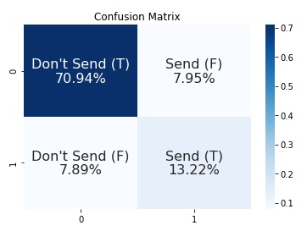
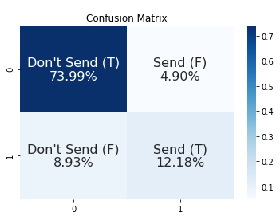
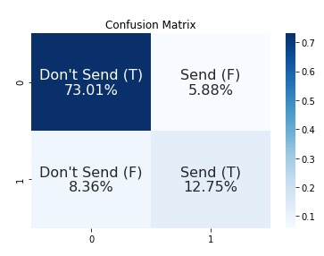
💯 Model Performance
Better than client model baseline!
But plateaus at ~84 - 85% accuracy
Across diff values of hyperparameters like lr, number of epochs
Hypothesis: Feature space not rich enough to learn more from?
LGBM Regressor
Accuracy - 84.16%
LGBM Classifier w/ user dictionary
Accuracy - 86.17%
User dictionary only
Accuracy = 85.76%

Slide 8

🤔 Next Steps
Statistical Feature Analysis track
Continue testing predictive power of individual features & combinations
Hopeful for insights to inform Wide Model design, in particular
Feature Engineering Track
Explore smarter ways to learn user ID embeddings
Currently difficult because no gold latent factors to build them
Learnt as part of training
Statistical Feature Analysis track insights to guide more activities in this track
Model Collection & Improvement Track
Testing on full dataset
Experiment with newer models like TabNet
Experiment with more action spaces
Improve existing models with insights from the other 2 tracks
And as always...

Slide 9

💭 Thoughts on Space Bandits
Space Bandits has minimal GPU support
Extensive use of Numpy, no Pytorch
Python for-looping over action space
Even for neural model, several processing bottlenecks in core functions
for e.g. Posterior Sampling uses only CPU multiprocessing
Context scaling with local statistics
In short, will be labour intensive to update codebase

Slide 10
🙏 Thank you for listening!
✋ Any Questions?

